Slide 2
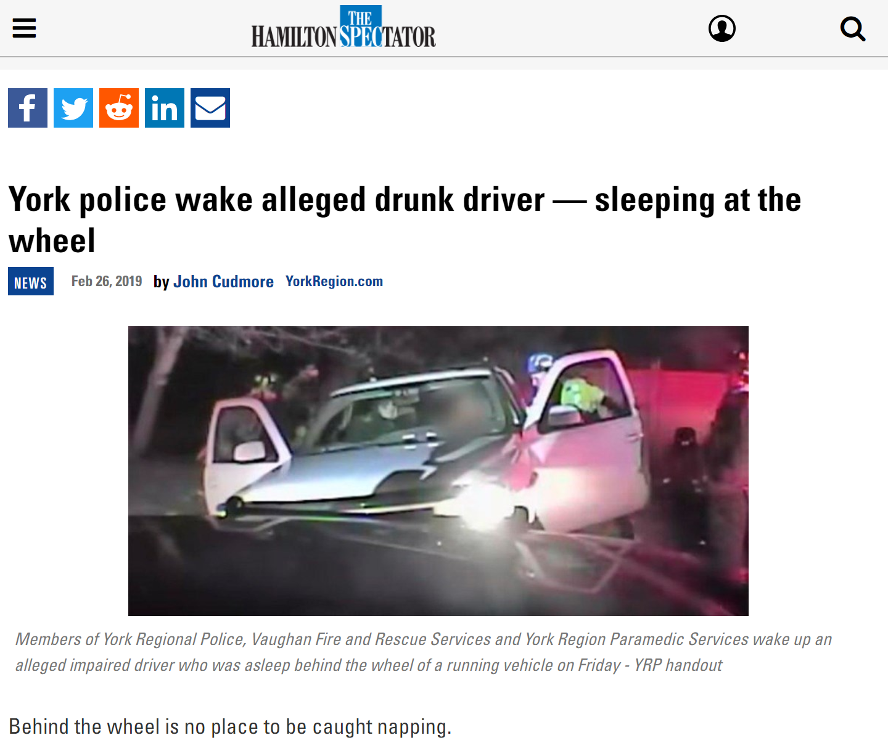
Notes:
Facts:
This usually happens when a driver has not slept enough, but it can also happen due to untreated sleep disorders, medications, drinking alcohol, or shift work.
No one knows the exact moment when sleep comes over their body.
An estimated 1 in 25 adult drivers (aged 18 years or older) report having fallen asleep while driving in the previous 30 days
The National Highway Traffic Safety Administration estimates that drowsy driving was responsible for 90,000 crashes, 44,000 injuries, and 800 deaths in 2017.
Drivers who do not get enough sleep:
Commercial drivers who operate vehicles such as tow trucks, tractor trailers, taxi (uber, lyft) and buses.
Shift workers (work the night shift or long shifts).
Drivers with untreated sleep disorders such as one where breathing repeatedly stops and starts (sleep apnea).
Drivers who use medications that make them sleepy.

Slide 3
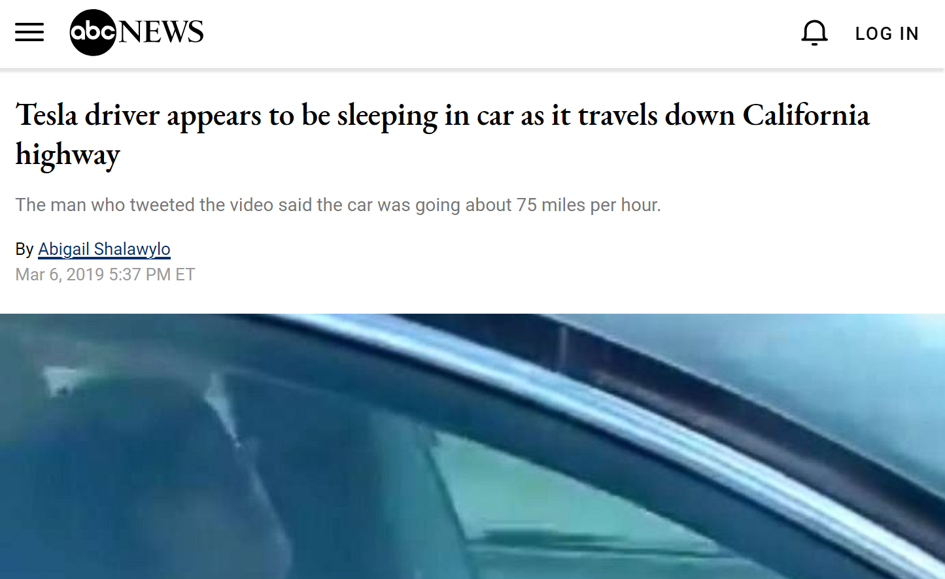
Notes:
Facts:
This usually happens when a driver has not slept enough, but it can also happen due to untreated sleep disorders, medications, drinking alcohol, or shift work.
No one knows the exact moment when sleep comes over their body.
An estimated 1 in 25 adult drivers (aged 18 years or older) report having fallen asleep while driving in the previous 30 days
The National Highway Traffic Safety Administration estimates that drowsy driving was responsible for 90,000 crashes, 44,000 injuries, and 800 deaths in 2017.
Drivers who do not get enough sleep:
Commercial drivers who operate vehicles such as tow trucks, tractor trailers, taxi (uber, lyft) and buses.
Shift workers (work the night shift or long shifts).
Drivers with untreated sleep disorders such as one where breathing repeatedly stops and starts (sleep apnea).
Drivers who use medications that make them sleepy.

Slide 4
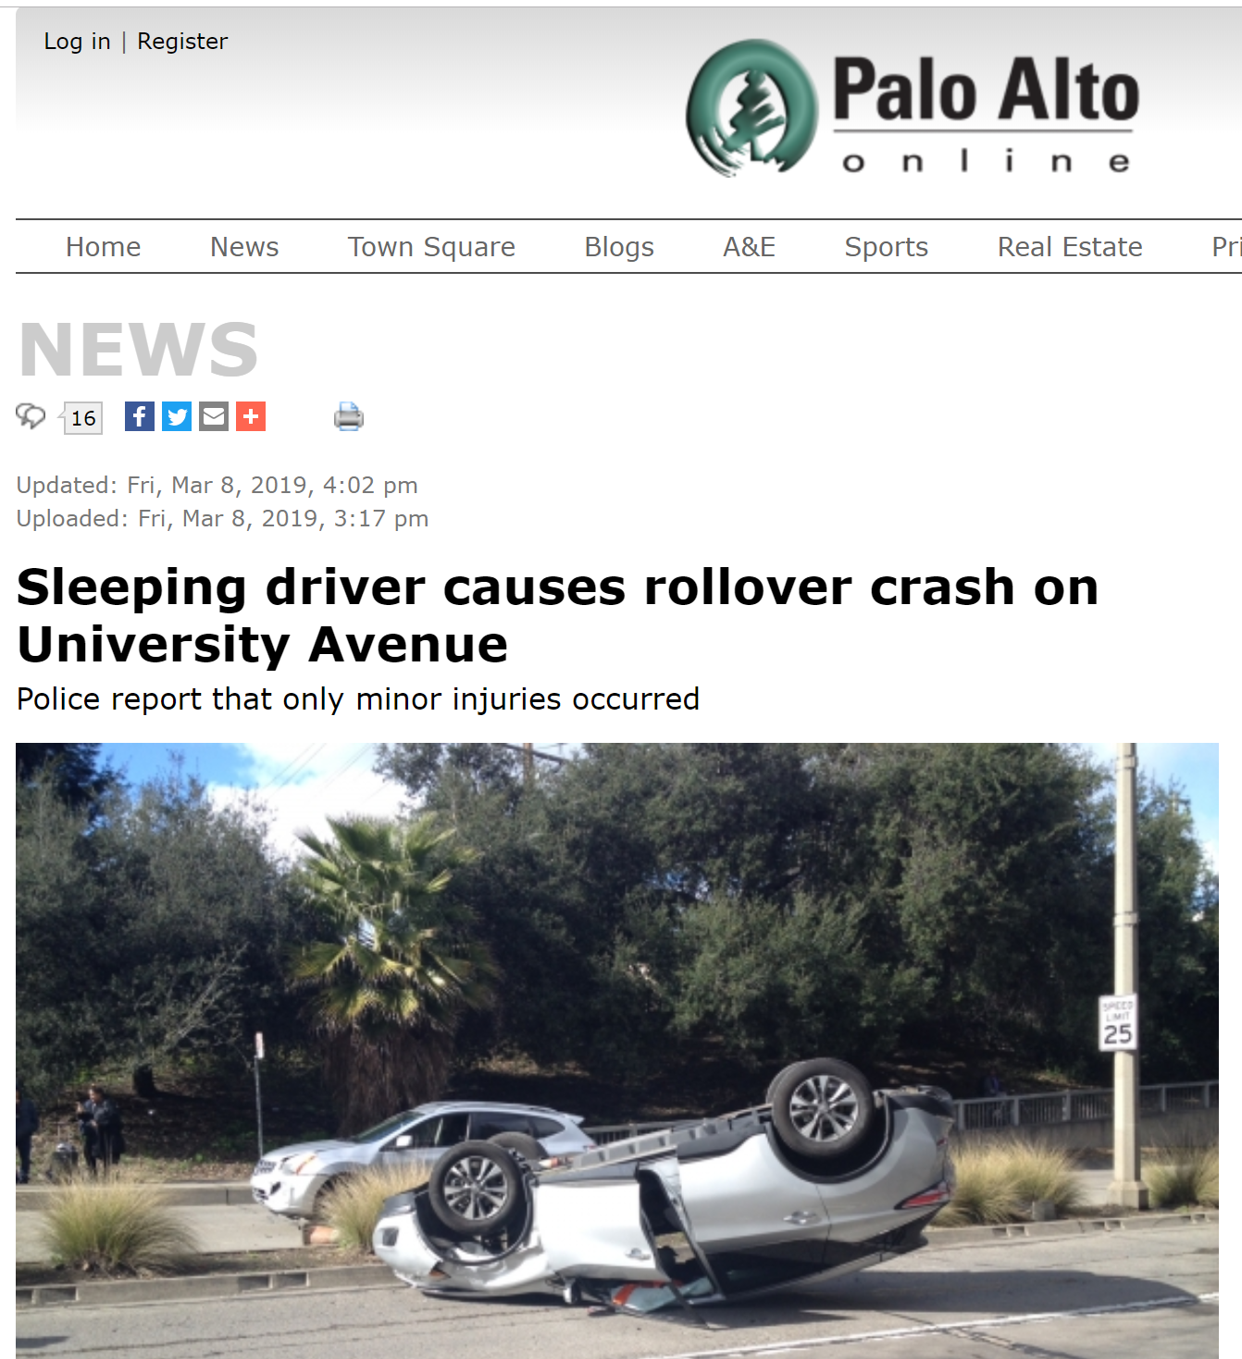
Notes:
Facts:
This usually happens when a driver has not slept enough, but it can also happen due to untreated sleep disorders, medications, drinking alcohol, or shift work.
No one knows the exact moment when sleep comes over their body.
An estimated 1 in 25 adult drivers (aged 18 years or older) report having fallen asleep while driving in the previous 30 days
The National Highway Traffic Safety Administration estimates that drowsy driving was responsible for 90,000 crashes, 44,000 injuries, and 800 deaths in 2017.
Drivers who do not get enough sleep:
Commercial drivers who operate vehicles such as tow trucks, tractor trailers, taxi (uber, lyft) and buses.
Shift workers (work the night shift or long shifts).
Drivers with untreated sleep disorders such as one where breathing repeatedly stops and starts (sleep apnea).
Drivers who use medications that make them sleepy.

Slide 5

INTRODUCING
DriveAlert

Slide 6
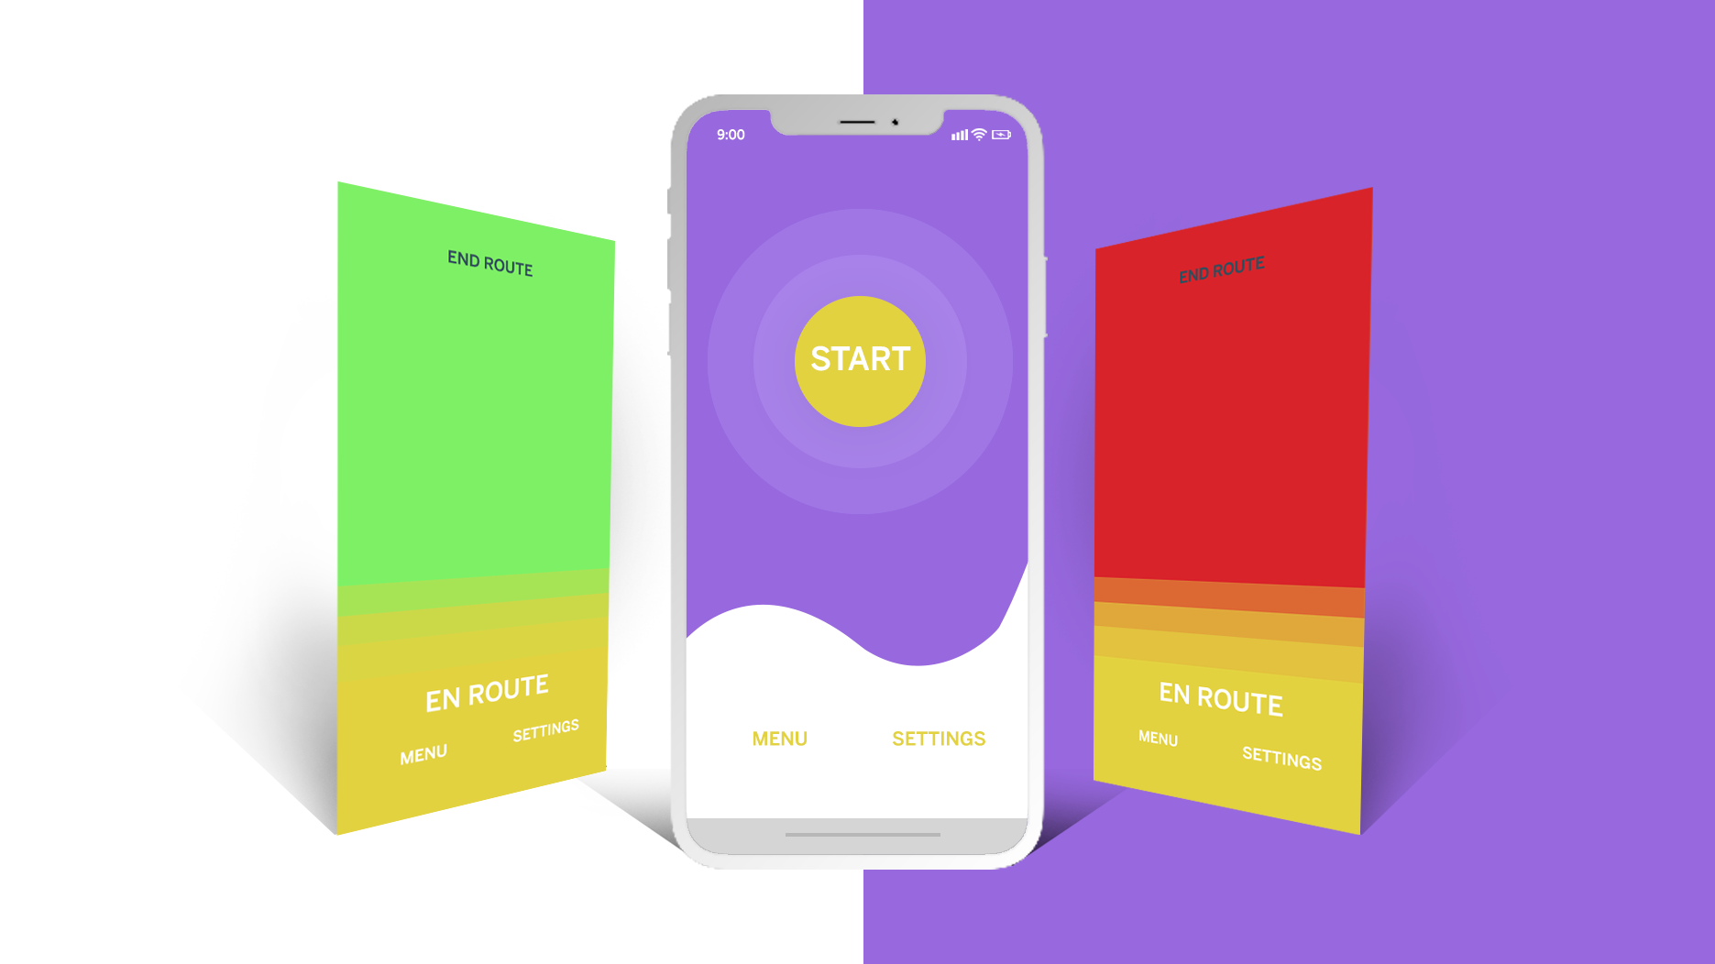

Slide 7
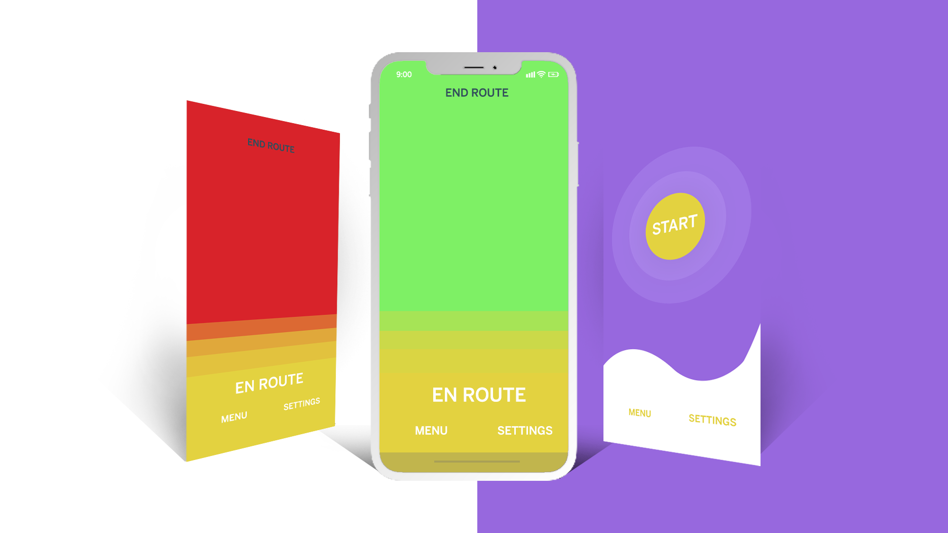


Slide 8
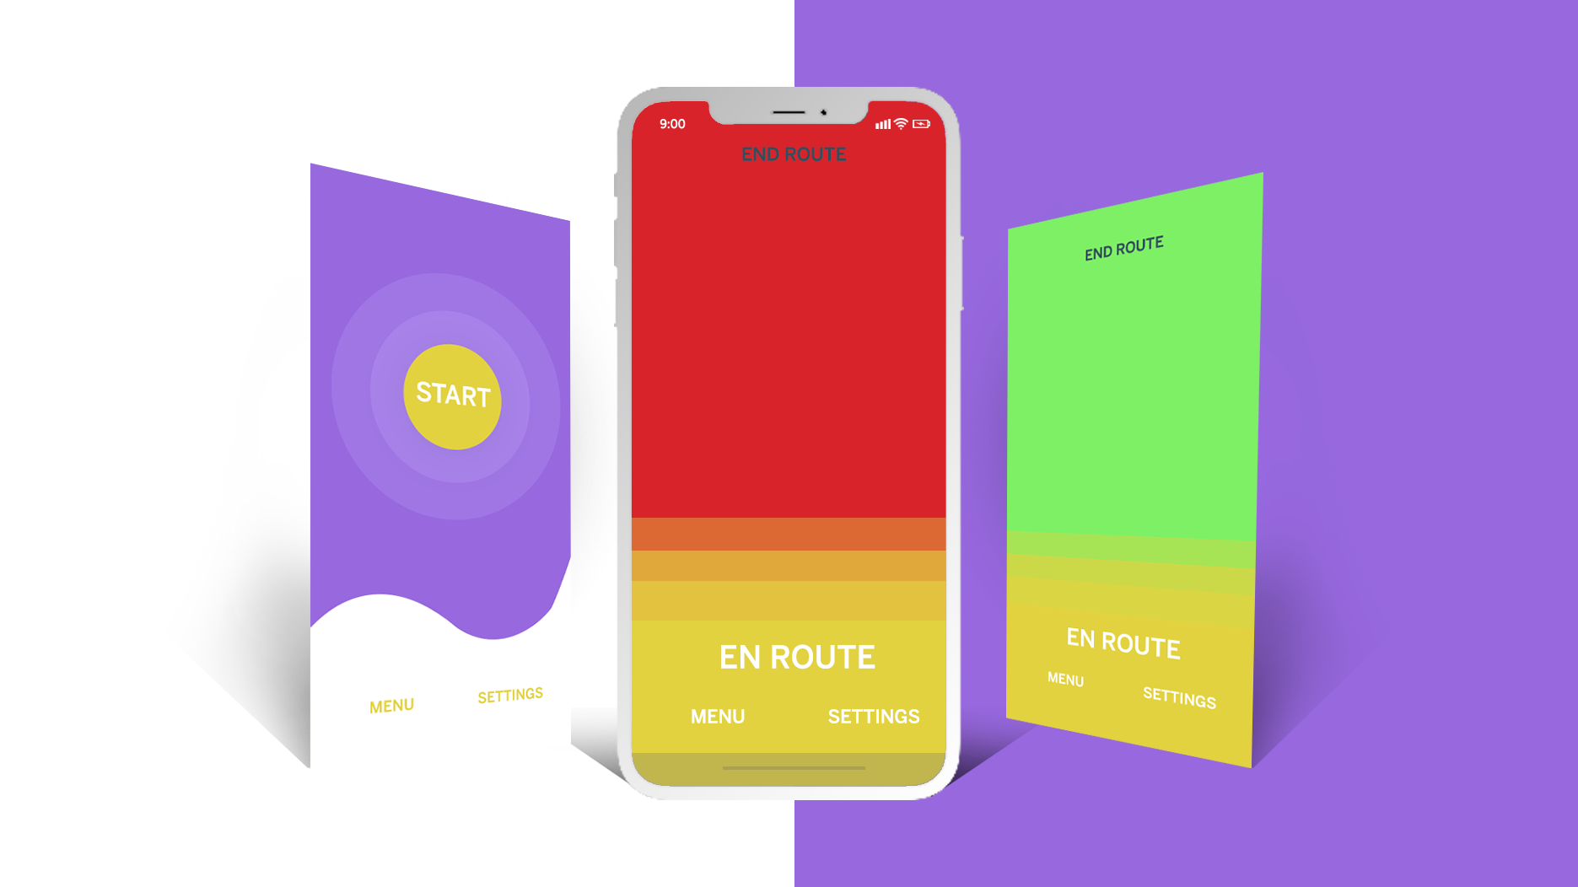

Slide 9
Drive Awake.
Drive Safe.
DriveAlert.

